Slide 1
OKI Freight Plan
OKI Intermodal Coordinating Committee Meeting
April 11, 2023

Slide 2
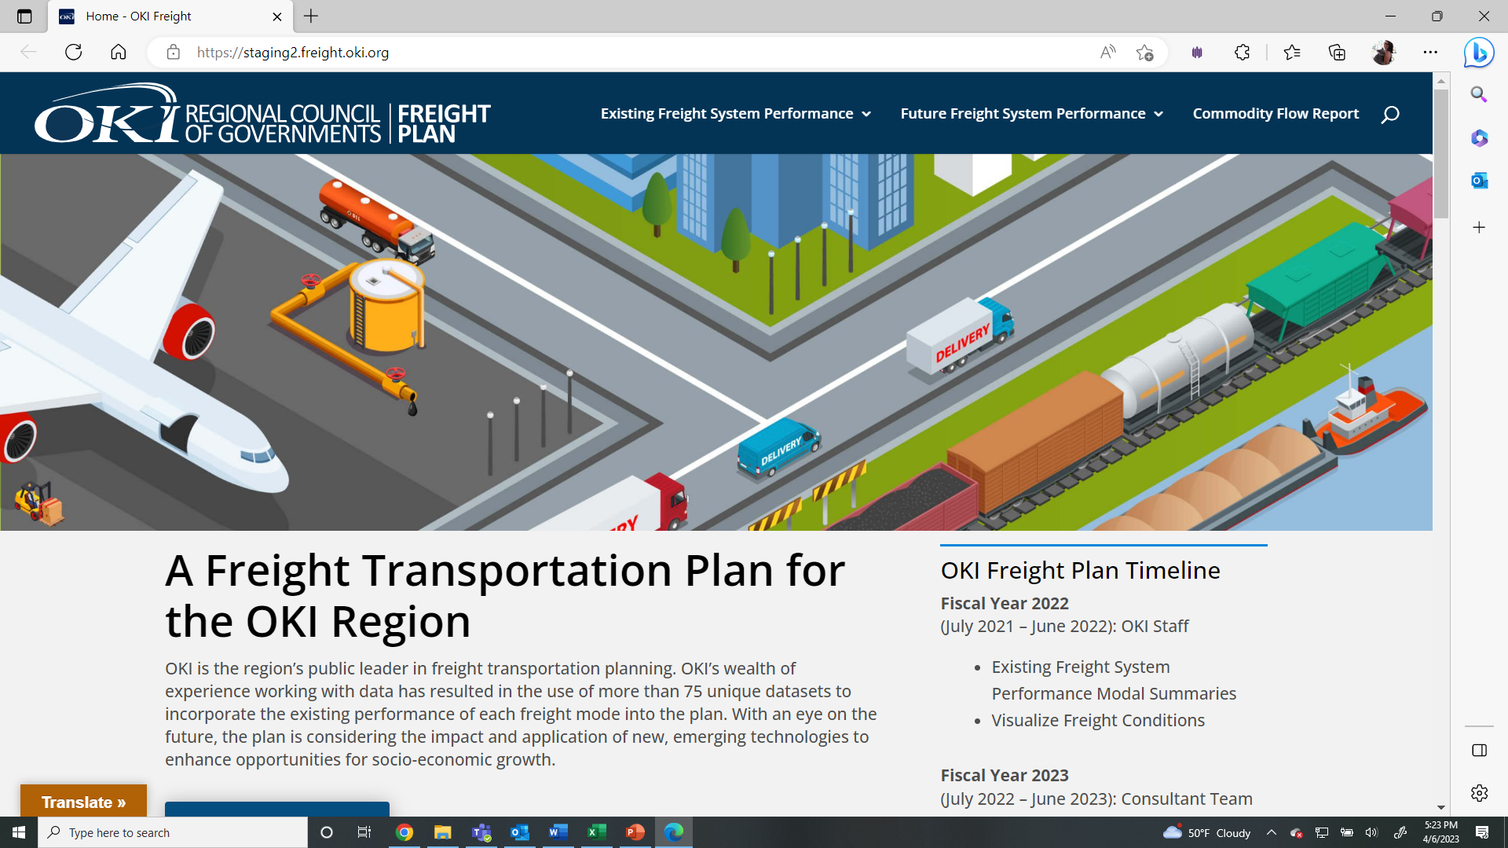
Freight.oki.org

Slide 3
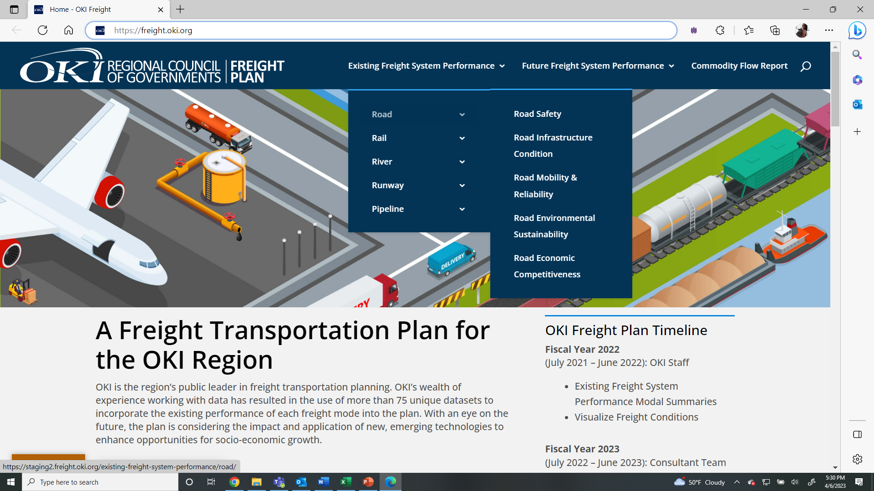
Freight.oki.org

Slide 4
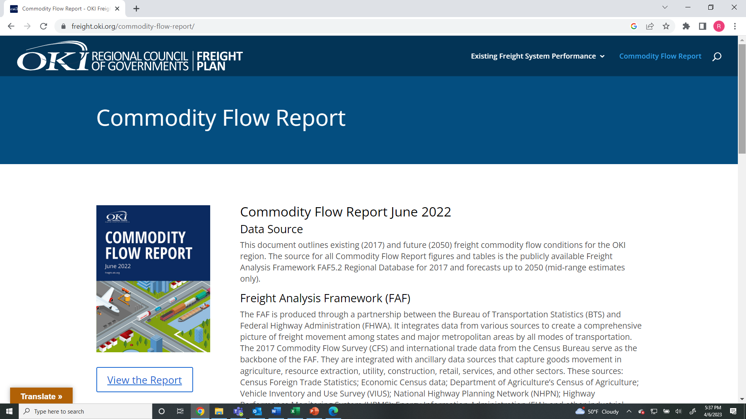
Freight.oki.org

Slide 5
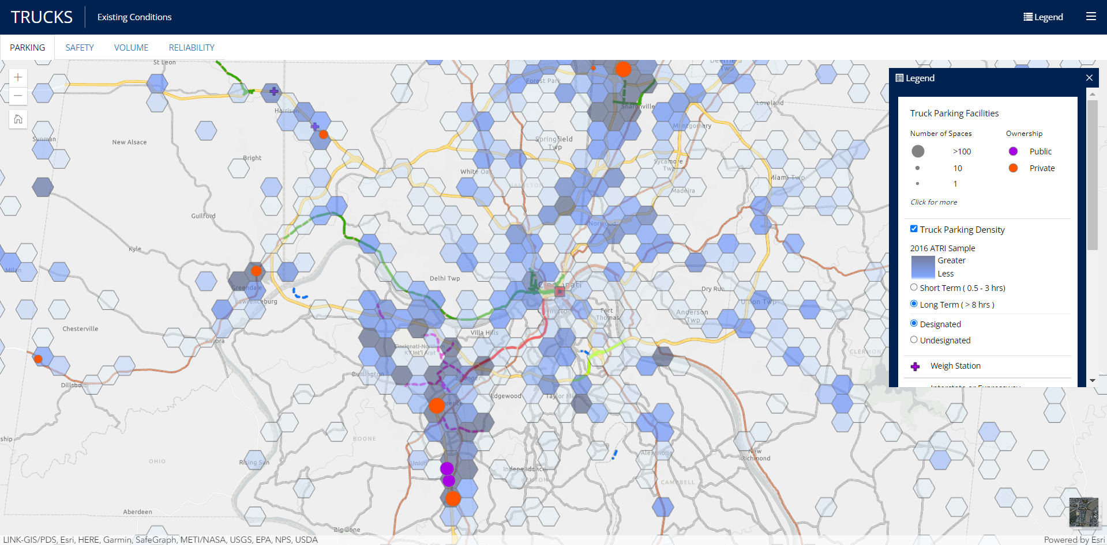
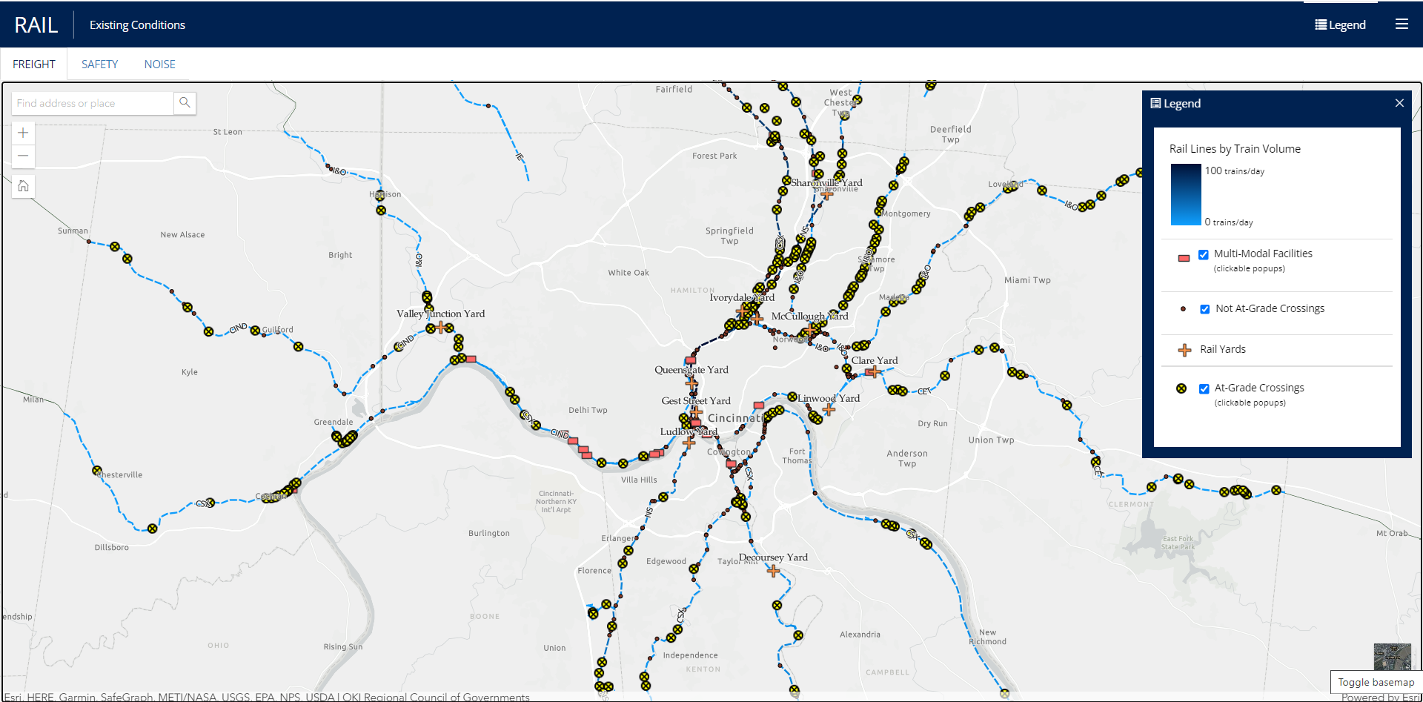
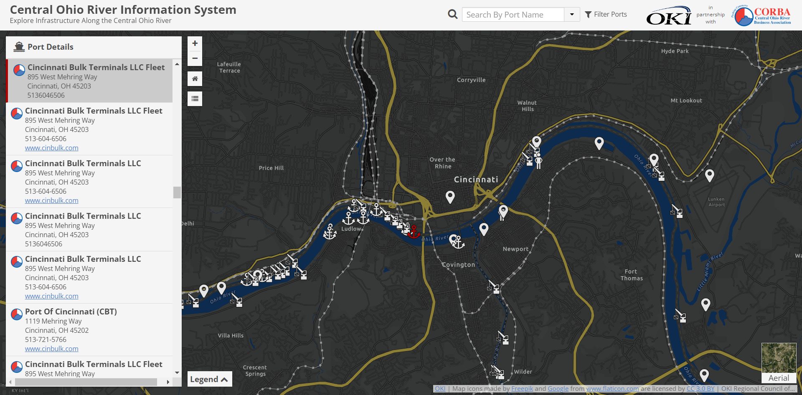
Freight.oki.org

Slide 6
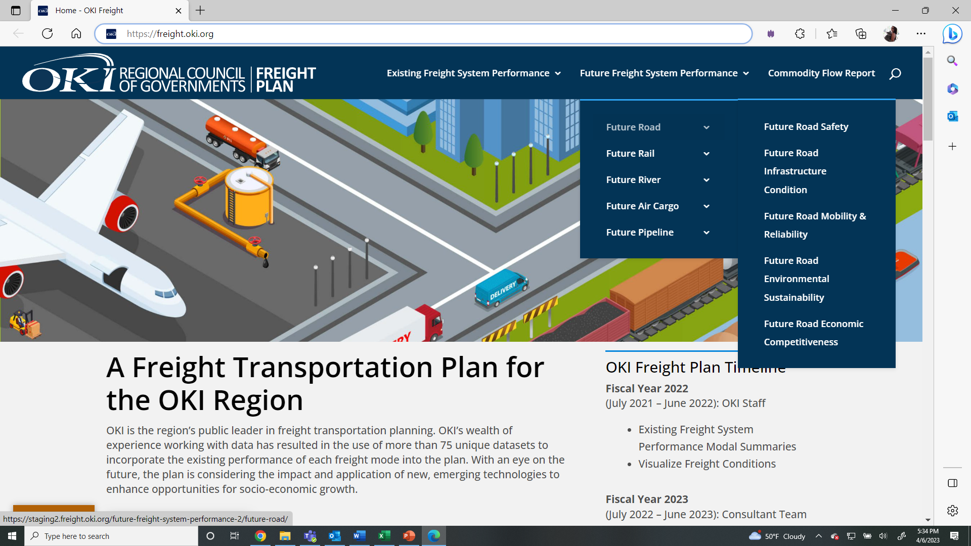
Freight.oki.org

Slide 7
Robyn Bancroft, AICP
Strategic Initiatives Manager
513.619.7662
rbancroft@oki.org
September 5-7, 2023
Hyatt Regency Cincinnati

