Slide 1
LPA Program Highlights
OKI ICC Meeting, Tuesday, June 6, 2023
Notes:
Welcome and intro

Slide 2
DEFINED
LPA Project:
Any project sponsored by a Local Public Agency, awarded state or federal transportation funding (administered by ODOT)
Example Funding Sources:
OKI STBG, TA, CMAQ; ODOT safety, CEAO, Office of Local Programs grants, TRAC, BIL Discretionary, Congressionally Directed Community Improvement Projects

Slide 3
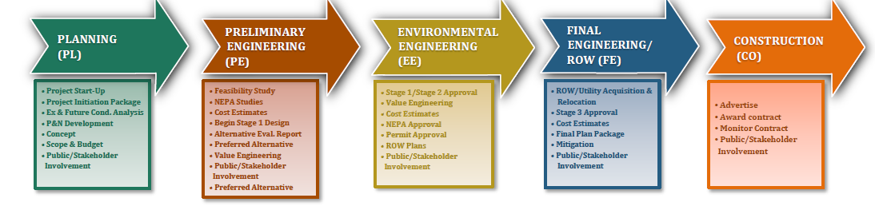

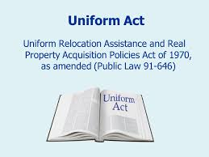

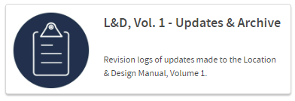
LPA Project requirements
ODOT’s Project Development Process
Subject to state and federal transportation policies, law, ODOT manuals and accepted design standards

Slide 4
LPA Project Delivery
Scope Meeting
  Define the state and federal requirements that apply
  Discuss the Project Development Process and set a project schedule
  Define roles
LPAs “drive” the PDP process
  Hire and manage consultants for design, environmental, and right of way acquisition
  Meet with ODOT to provide status updates and lock the schedule during ODOT’s lock-down process
  Staying on scope, schedule, and within budget are key to successful delivery
  Delivering the plan package and awarding the project on-time are key measures that ODOT tracks
ODOT provides oversight:
  Responsibility to ensure federal requirements (e.g. NEPA & Uniform Act) are met
  Project design review (scope & applicable design criteria);
  Adherence to project schedule (including “lock-down”)

Slide 5
Construction contract delivery

Slide 6
LPA Project Delivery
Key Differences (ODOT-Let vs. Local-Let)
Plan Development Format
Project Agreements & Legislation
Project Schedule (ODOT’s letting process)
Construction Administration & Inspection
Cash Flow

Slide 7
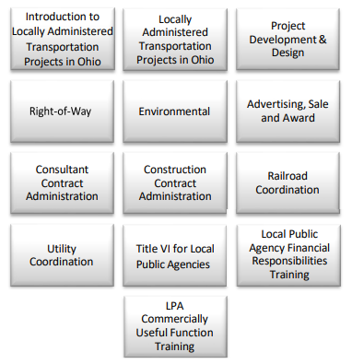
Local-let participation requirements
Two-step LPA Certification Process
Complete 12 Online e-Learning Modules (good for 5 years)
Complete “LPA Participation Requirements Review Form” (good for 4 years)

Slide 8
Local-let participation requirements
LPA is required to:
Designate an “LPA Person in Responsible Charge”
Identify who will serve as the “Construction Project Engineer”
Provide examples of past transportation projects delivered
Clarify processes and policies to ensure compliance for:
Consultant selection | Consultant management
Right of way acquisition | Environmental (NEPA)
Finance & Accounting | Recordkeeping
Advertising, sale, & award | Change Orders
Dispute resolution | Claims management
DBE requirements | Prevailing wages

Slide 9
Final thoughts
Communication is a major key to success
  Ask to be added to my LPA email list
  Be proactive in communicating issues or delays
  ODOT & OKI can assist when budget issues arise
Timely delivery is very important!
ODOT can assist with items like reviewing consultant scopes to ensure items don’t get missed

Slide 10
District 8 LPA Contacts
Andrea Henderson, P.E., District 8 LPA Coordinator
Andrea.Henderson@dot.ohio.gov
513-933-6528
Ben Miller, District 8 LPA Right of Way Coordinator
Ben.Miller@dot.ohio.gov
513-933-6655
Paul Maricocchi, E.I., LPA Project Manager
Paul.Maricocchi@dot.ohio.gov
513-933-6586
Tom Makris, P.E., MBA, LPA Construction Monitor
Tom.Makris@dot.ohio.gov
513-933-6619

Slide 11
Questions
?

