Slide 1

OKI Carbon Reduction Pilot Program
Project Selection
ICC June 6, 2023

Slide 2

OKI Carbon Reduction Program Pilot Program
OKI Pilot Program is for the installation of publicly accessible electric vehicle charging infrastructure
Utilize OKI Carbon Reduction Program (CRP) federal transportation funds suballocated to OKI
Preference for DC Fast Charging (DCFC) equipment but will consider Level 2 equipment.

Slide 3
CRP Pilot Program Timeline
February 22, 2023 – Applications available
May 5, 2023 – Applications due to OKI
June 6, 2023 – ICC reviews staff recommendations
June 8, 2023 – OKI Board of Directors selects projects for award
June 8, 2023 – Projects added to OKI Transportation Improvement Program
After June 8, 2023 – Coordination of scope & schedule with ODOT/KYTC/INDOT

Slide 4
2023 Pilot Program Synopsis
Type | Funding Available | Applications Received | Funding Requested
Ohio CRP | $5 m | 6 | $1,275,533
Kentucky CRP | $2 m | 2 | $1,250,000
Indiana CRP | $30k | 0 | 0
Notes:
This table shows important details on requirements, extent and amounts available by fund type.

Slide 5
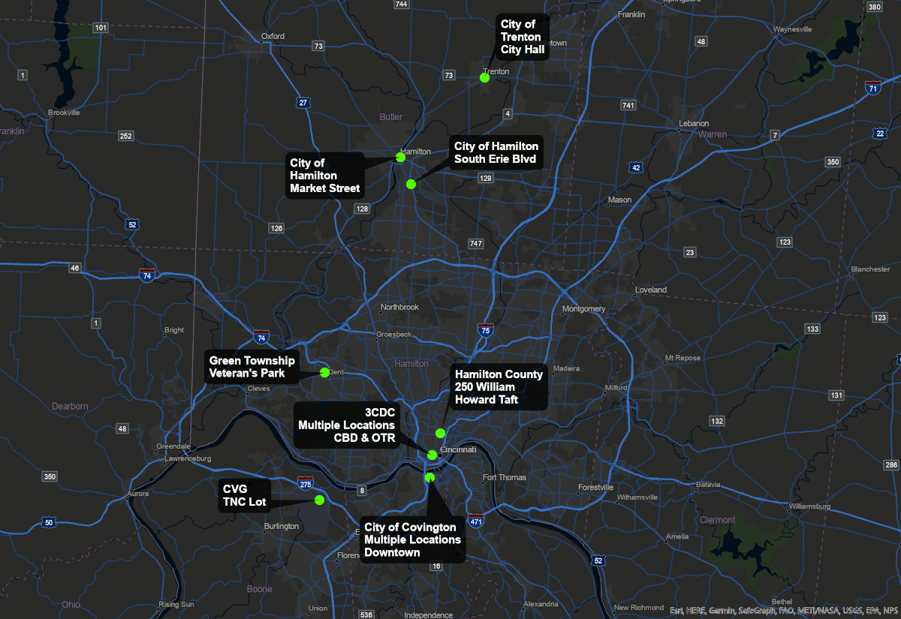
Notes:
6 applications in Ohio and 2 in Kentucky

Slide 6
Cincinnati Center City Development Corportation (3CDC)
Level 2 Chargers at 5 Parking Facilities
  Washington Park Garage (OTR)
    4 dual port level 2
  Mercer Garage (OTR)
    3 dual port level 2
  1400 Vine Surface Lot (OTR)
    3 dual port level 2
  Fountain Square Garage (CBD)
    5 dual port level 2
  Fifth and Race Garage (CBD)
    5 dual port level 2
Federal Funds $558,751
Local (20% match) $139,688
Total Estimate $698,439

Slide 7
City of Covington
Level 2 & DCFC’s at 4 Parking Facilities
  Rivercenter Garage (10 E. River Center Blvd)
  Mid-town Garage (15 E. 5th St.)
  Pershing lot (323 Pershing St.)
  Philadelphia St. lot (south of 5th)
Total of twenty Level 2 and six DCFC
Federal Funds $500,000
Local (20% match) $125,000
Total Estimate $625,000

Slide 8
CVG Airport (Kenton County Airport Board)
Four DCFC’s
  “TNC” Parking Lot (Uber/Lyft) along Lincoln Road
Federal Funds $750,000
Local (21% match) $200,000
Total Estimate $950,000

Slide 9
Green Township
Two DCFC’s
  Green Twp Government Complex parking lot adjacent to Veteran’s Park
Federal Funds $213,000
Local (25% match) $71,000
Total Estimate $284,000

Slide 10
Hamilton County Department of Environmental Services
Four Level 2 Chargers
  Parking lot of HCDOES facility (Civic Center Dr)
  Requesting turn-key provider to cover unit cost, maintenance and operation
Federal Funds $32,610
Local (20% match) $8,170
Total Estimate $40,800

Slide 11
City of Hamilton – 2216 S. Erie Blvd.
Four DCFC’s
  Adjacent to City of Hamilton Public Works and CNG Filling Station
Federal Funds $292,528
Local (20% match) $73,132
Total Estimate $365,660

Slide 12
City of Hamilton – 141 Market Street
Two DCFC’s
  Existing surface lot on Market Street
  Install electric connections for an additional two future chargers.
Federal Funds $148,624
Local (20% match) $37,156
Total Estimate $185,780

Slide 13
City of Trenton
Two DCFC’s
  City Hall parking lot, 11 East State Street
NOT RECOMMENDED: Incomplete information provided in application
Federal Funds $30,000
Local (45% match) $25,000
Total Estimate $55,000

Slide 14
2023 Pilot Program Scoring
Notes:
8 scoring factors for a maximum of 60 points. We believe we have enough funds to cover all the projects. Even in Kentucky, if we include FY24 money, we have enough.

Slide 15
Ohio Project Recommendations | Federal Funds | Local Match
Cincinnati Center City Development Corporation (3CDC) | $558,751 | 20%
Green Township | $213,000 | 25%
Hamilton County Department of Environmental Services | $32,630 | 20%
City of Hamilton | $441,152 | 20%
Kentucky Project Recommendations | Federal Funds | Local Match
City of Covington | $500,000 | 20%
CVG Airport | $750,000 | 21%
Notes:
Possibly a new call for projects in the Fall.

